Slide 1
Deploy Churn Prediction Models with REST APIs and Cloud GCP
Duc Duong
2022-02-08

Slide 2
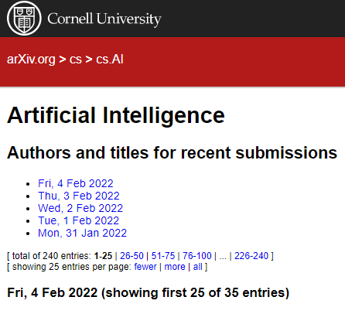

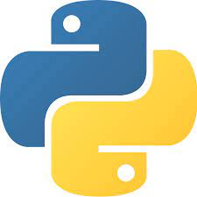

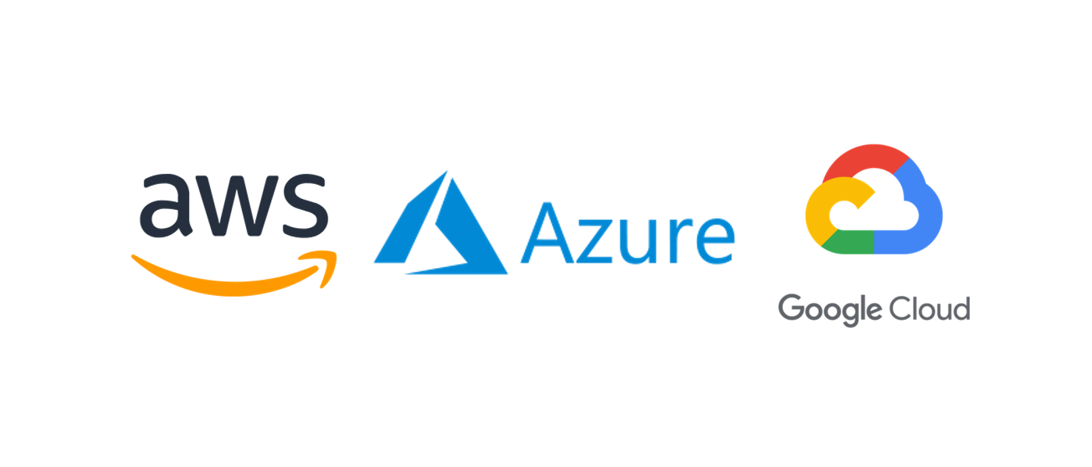
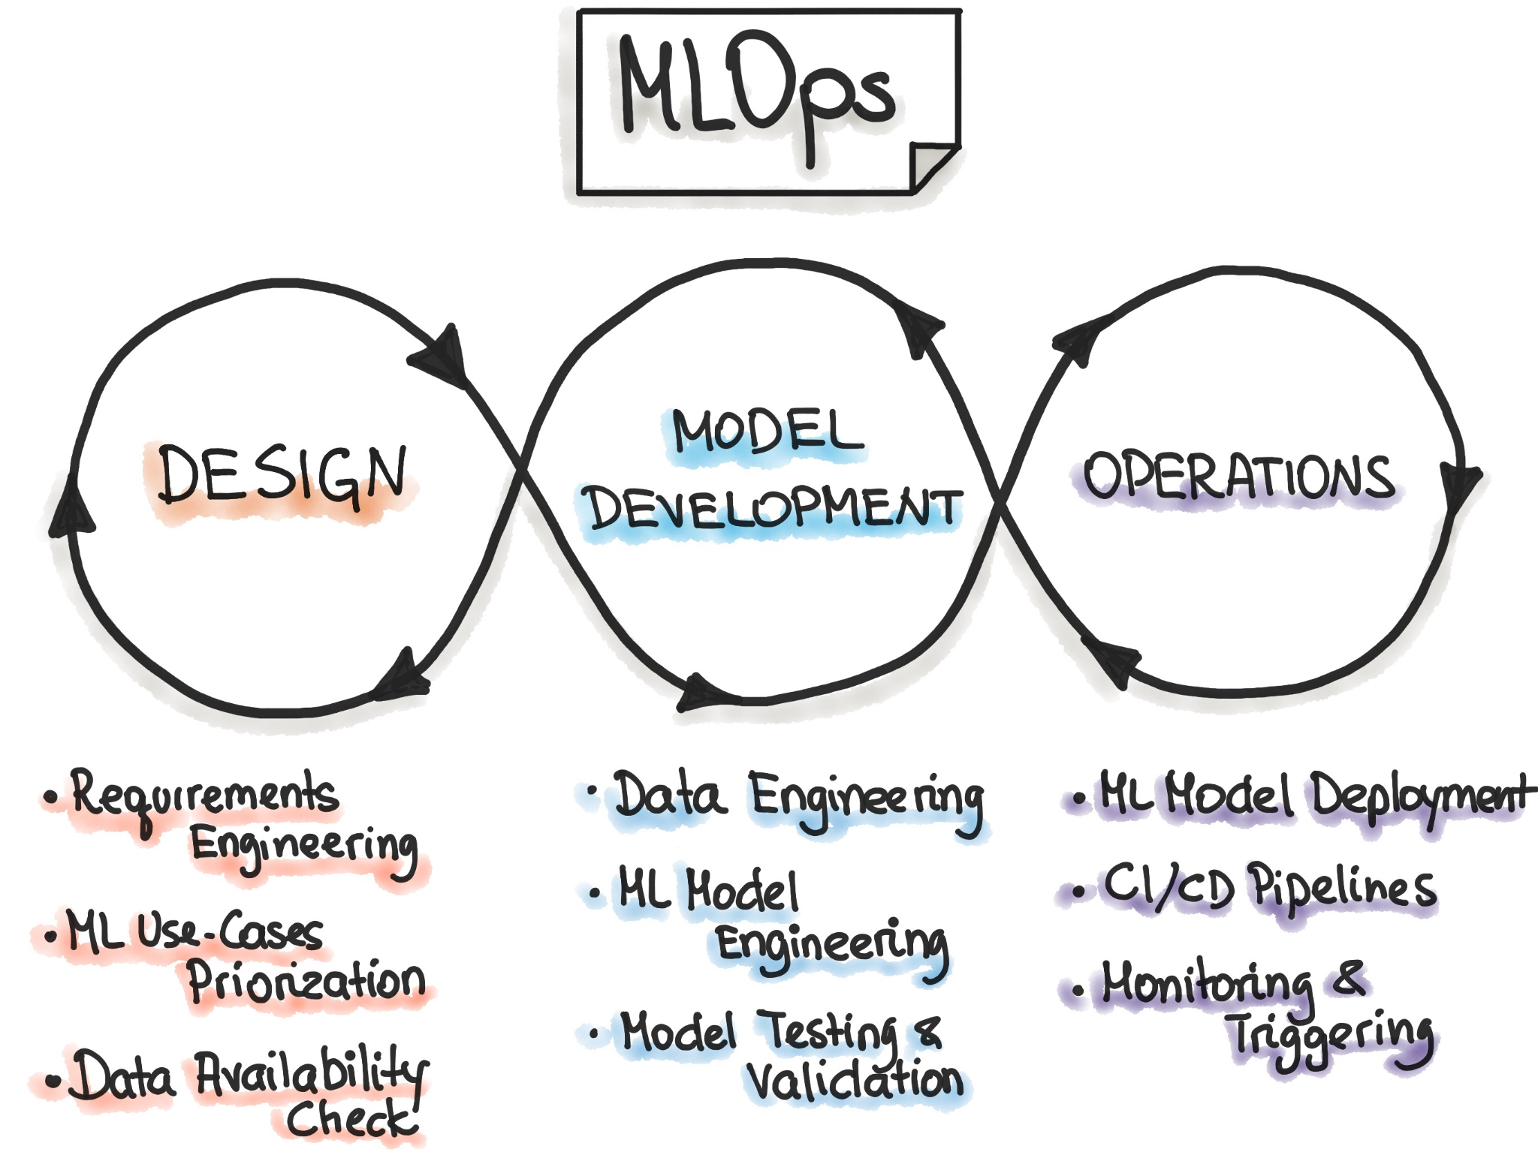



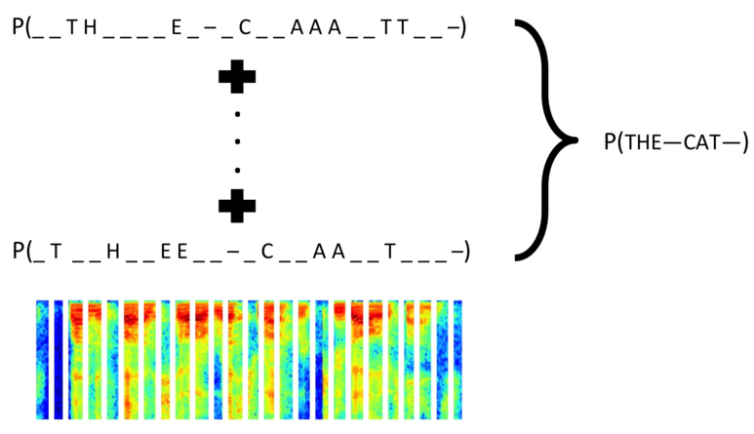
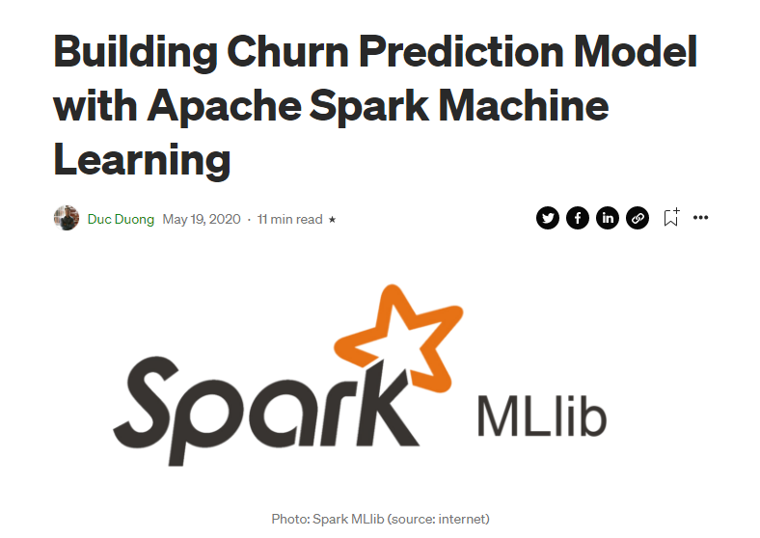
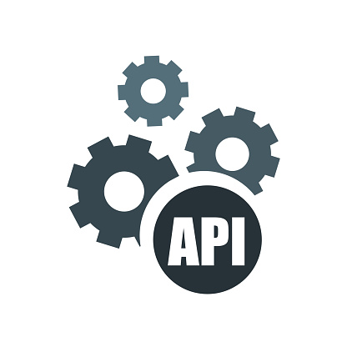
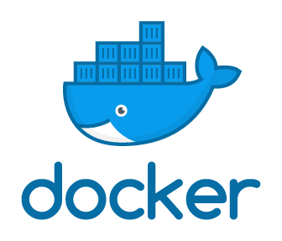

Motivation
THE JOURNEY TO PRODUCTION

Slide 3
Project Overview
Objectives: Create a Churn Prediction Model and API and Deploy into the Cloud
The model and API takes some input variables and predict whether the client will churn or not.
Deliverables
Predictions models of Customer Churn Prediction
API endpoint to predict Customer Churn deployed into the Cloud
A front-end app for demonstration

Slide 4
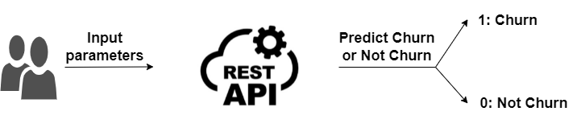
High Level Design
{
"total_visits":100,
"average_time_spent":200000
}
The prediction is [0]
{
"total_visits":10,
"average_time_spent":2000
}
The prediction is [1]

Slide 5





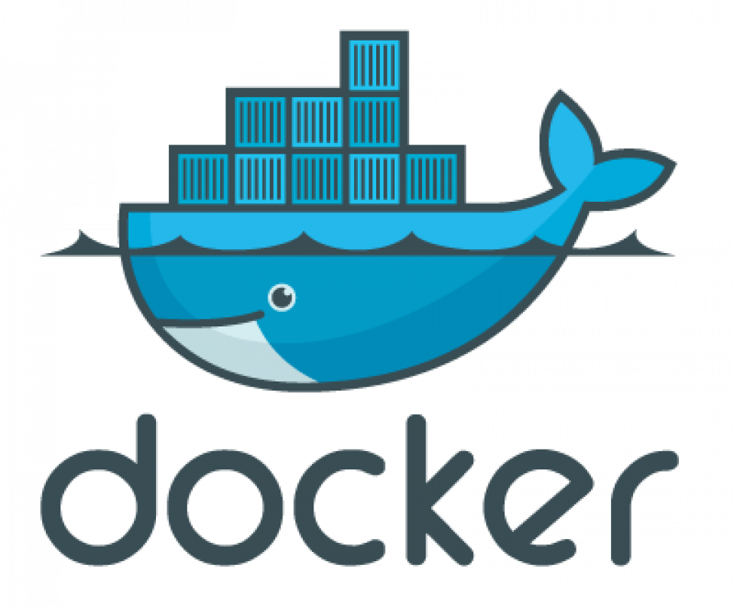
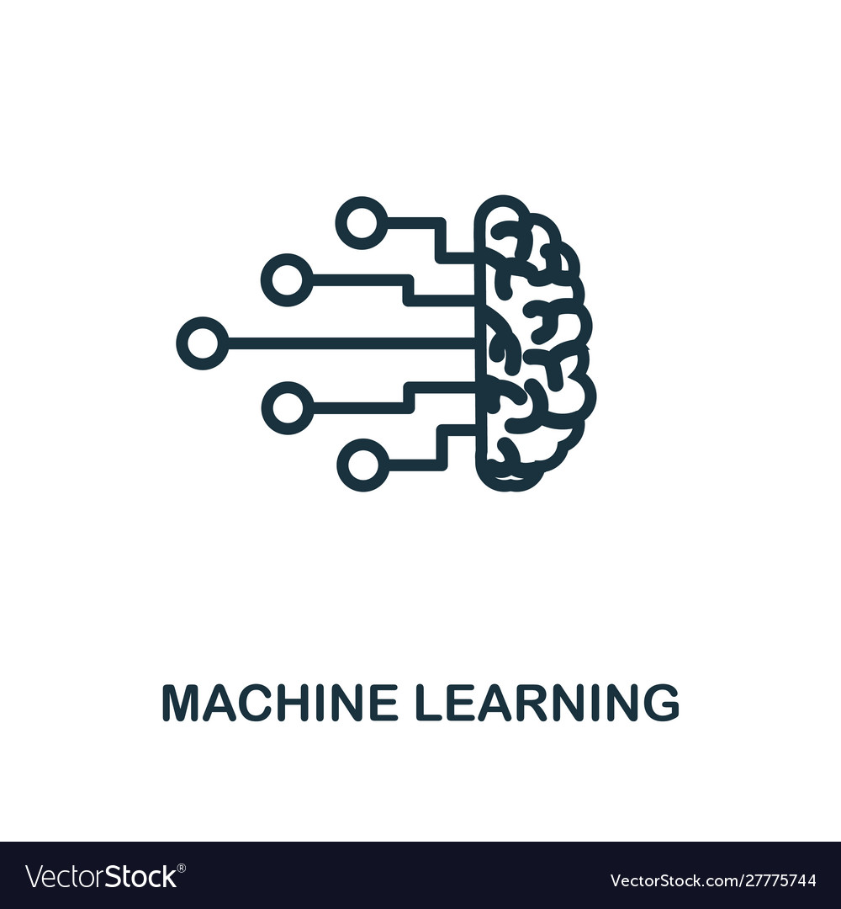

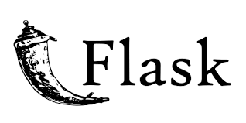
Deployment Stack
Sklearn
Data Processing
Feature Engineering
Model Selection
Docker
Serverless
LIFECYCLE MANAGEMENT
MACHINE LEARNING
FLASK API FRAMEWORK

Slide 6



Demo

Slide 7
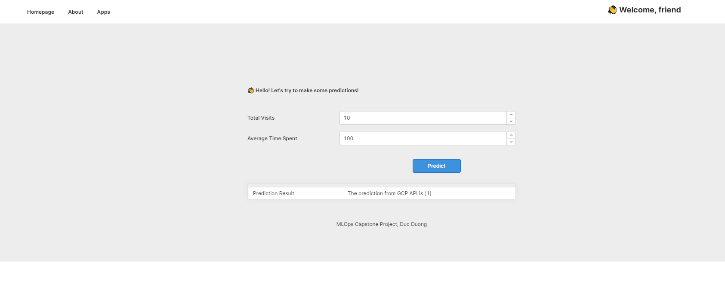
Demo

Slide 8
What’s Next?
Deploy in cluster nodes with Kubernetes
Integrate with monitoring layer
Integrate with CD/CI/CT pipelines
Integrate with Spark for Big Data Processing and SparkML
Etc.

